Slide 1
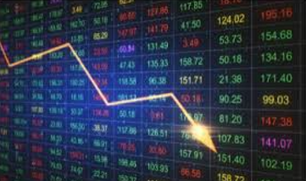
Leveraging Machine Learning for Predictive Price Analytics & Algorithmic Trading Strategy Optimization
Ranjan Kumar Jha
University ID: UP2301022
Masters in Artificial Intelligence & Machine Learning (MSc AI&ML)
Part Time, 2004-2005
M33876 MASTERS PROJECT

Slide 2
PROBLEM STATEMENT
The financial markets are characterized by high volatility, complex dynamics, and vast
amounts of real-time data, making traditional trading strategies increasingly
inadequate. There is a growing need for intelligent, data-driven approaches that can
effectively forecast price movements and optimize trading decisions.
This dissertation addresses the central problem:
How can advanced machine learning techniques be leveraged to improve the accuracy
of stock price predictions and enhance the performance of algorithmic trading strategies
in a scalable and interpretable manner?
Specifically, the research explores:
Forecasting stock prices (e.g., Bank of America Inc.) using LSTM neural
networks within a big data ecosystem (PySpark).
Optimizing trading strategies through:
Unsupervised learning for market pattern detection in the S&P 500.
Sentiment analysis on Twitter data for NASDAQ stock ranking.
Hybrid intraday strategies using GARCH models and technical indicators.
The overarching goal is to design a modular, explainable, and scalable framework that
integrates AI, ML Deep Learning, and statistical modeling for intelligent algorithmic
trading in modern financial markets.

Slide 3
THESIS CONTRIBUTIONS
This dissertation makes the following key contributions:
LSTM-Based Price Prediction: Implementation of deep learning models for forecasting the closing price of BAC stock using LSTM and Yahoo Finance data.
Scalable Big Data Pipeline: Integration of PySpark for streaming and parallel processing of financial datasets, enabling real-time analytics.
Multi-Strategy Algorithmic Trading System: Development and comparison of three distinct AI-powered strategies:
• Unsupervised learning on S&P 500 for portfolio optimization.
• Twitter sentiment analysis for NASDAQ stock ranking.
• Hybrid intraday strategy using GARCH models with technical indicators.
Performance Evaluation: Backtesting and benchmarking of strategies against standard
indices (e.g., QQQ), showcasing profitability, risk metrics, and model generalizability.
Modular, Explainable Framework: Proposal of a flexible architecture that can be
extended to other financial instruments, enabling transparency and adaptability in
financial AI systems.

Slide 4
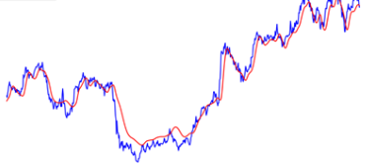
RESEARCH OBJECTIVE (STUDY BASED )
To explore and implement predictive analytics techniques for stock price forecasting using machine learning and deep learning.
To leverage LSTM networks and PySpark MLlib for real-time, scalable financial data processing.
To design, implement, and evaluate AI-based trading strategies that incorporate historical, technical, and sentiment-based indicators.
To benchmark the performance of these strategies against market indices and assess their robustness and adaptability.

Slide 5
SIGNIFICANCE OF THE STUDY
Bridges Research and Practice
Demonstrates how machine learning techniques like LSTM, PySpark MLlib, and
Twitter based sentiment analysis can be applied in real-world trading environments.
Advances Intelligent Trading Systems
Proposes adaptive, data-driven models that outperform traditional benchmarks and
improve risk-adjusted returns.
Enables Scalable Financial Analytics
Utilizes big data infrastructure (PySpark) for handling large volumes of financial
data, enabling faster and more scalable decision-making.
Contributes to Academic Knowledge
Expands literature on hybrid trading strategies, combining time-series forecasting,
volatility modeling (GARCH), and ML techniques.
Benefits Industry Stakeholders
Offers actionable insights for traders, fintech developers, and financial institutions seeking to enhance trading performance, risk management, and execution efficiency.

Slide 6
RESEARCH METHODOLOGY
Approach:
Modular, strategy-based methodology demonstrating AI in algorithmic trading
Implemented in Python using libraries like scikit-learn, keras, pandas, TensorFlow,
pypfopt, stats model library
Common Workflow Across Strategies:
Data Acquisition – API-based (e.g., yfinance)
Preprocessing – Scaling, cleaning, handling bias
Feature Engineering – Tailored per strategy
Model Training – DL, clustering, or GARCH models
Backtesting – Historical performance testing
Evaluation – Sharpe Ratio
Tools Used:
ML/DL/Library: TensorFlow, Keras, scikit-learn, pySpark
Stats: statsmodels
IDE: Jupyter Notebook
Finance: pypfopt, yfinance

Slide 7
Continued..
1. LSTM Price Forecasting (BAC Stock)
Deep learning to predict future stock prices
RMSE & MAE for evaluation
2. Clustering for Portfolio Optimization (S&P 500)
K-Means for behaviour-based grouping
Momentum-driven selection with Efficient Frontier
3. Twitter Sentiment Investing (NASDAQ 100)
VADER for sentiment scoring
Equal-weighted portfolio from top sentiment-ranked stocks
4. Intraday Volatility Trading (GARCH)
Combines daily GARCH volatility forecast with intraday technical signals
Trade alignment across timeframes for same-day exit
Key Outcome: Each module showed positive alpha generation and strategy robustness under different market conditions.

Slide 8
LITERATURE REVIEW – KEY THEMES & CONTRIBUTIONS
AI & ML in Financial Trading
Transition from rule-based systems to data-driven models
Focus on clustering, sentiment analysis, volatility forecasting, and portfolio optimization
1. Stock Price Prediction with LSTM
LSTM outperforms ARIMA/GARCH for nonlinear time-series (Fischer & Krauss, 2018)
Attention mechanisms improve sequence relevance (Qin et al., 2017)
This work applies LSTM + attention + batch norm for BAC stock forecasting
2. Big Data Processing with PySpark & Kafka
PySpark supports scalable ML (Zaharia et al., 2016)
Real-time data via Kafka enables responsive strategy pipelines
3. Unsupervised Clustering in Markets
K-Means used for momentum-based stock grouping (Avellaneda & Lee, 2010)
Novel contribution: RSI-driven cluster initialization improves interpretability
4. Twitter Sentiment in Investing
Twitter sentiment can predict index movement (Bollen et al., 2011)
This research: sentiment-based stock ranking with monthly rebalancing

Slide 9
Continued..
5. GARCH for Intraday Volatility Forecasting
GARCH models short-term volatility clustering (Bollerslev, 1986)
Combined with intraday RSI/MACD for dual-signal execution
Adds real-time trade alignment to traditional GARCH forecasts
6. Portfolio Evaluation & Optimization
Risk-adjusted metrics: Sharpe Ratio
Efficient Frontier used for weight optimization (Markowitz, 1952)
Benchmarked against equal-weight portfolios (DeMiguel et al., 2009)
Positioning in Existing Research
This dissertation contributes to literature by integrating multi-strategy AI techniques under a unified workflow:
•It enhances clustering-based models with domain-specific initialization for better interpretability.
•It introduces engagement-weighted sentiment investing, offering a pragmatic variant to pure NLP-driven approaches.
•It builds a full-stack intraday framework combining GARCH, RSI, and trade simulation on multiple timeframes.
•It ensures rigorous risk-adjusted evaluation and benchmarking, adding robustness to each strategy’s validation cycle.

Slide 10
REASON FOR CHOOSING THIS PROJECT
Relevance to Current Financial Trends
The project aligns with current trends in fintech innovation, algorithmic trading, and AI integration, offering practical value to traders, financial analysts, and technology firms.
Focus on Technological Innovation
The title emphasizes the integration of advanced machine learning techniques, highlighting that the project is not just about prediction but about using cutting-edge technology to enhance accuracy and insight.
Market-Driven Insights
The title reflects the project’s goal of delivering data-driven market insights, underscoring that it’s not just a theoretical exercise, but a practical tool for understanding market behavior.
Emphasizing Predictive Accuracy
The title stresses that machine learning models are designed to improve the accuracy of stock market predictions, positioning your project as a solution to the inherent volatility of financial markets.
Desire to Build a Comprehensive Framework
The goal was to create an end-to-end, modular, and interpretable solution that integrates AI, big data, and financial modeling into a unified trading strategy toolkit.
Addressing Real-World Challenges
Traditional trading systems struggle with market volatility and data complexity. This thesis aims to develop adaptive, data-driven models that can respond to such challenges effectively.
Bridging Theory and Practice
This research offers the opportunity to connect advanced AI techniques—such as LSTM networks, PySpark MLlib,
Statistical Models and sentiment analysis—with real-world financial market applications

Slide 11
NOVELTY & RESEARCH CONTRIBUTION
Multi-Strategy AI Framework
Introduces a modular approach integrating LSTM networks, unsupervised learning, sentiment
analysis, and GARCH-based volatility models—rarely combined in a single system.
Big Data Integration with PySpark
Leverages PySpark MLlib for scalable and parallel processing of large financial datasets
enhancing performance and real-time applicability.
Cross-Disciplinary Innovation
Fuses machine learning, natural language processing, and statistical finance to form an
intelligent system for predictive analytics and trading optimization.
Real-World Relevance
Evaluates strategies using actual stock data (e.g., BAC, NASDAQ, S&P 500) and compares
them against benchmark indices (QQQ) using risk-adjusted performance metrics.
Explainable and Scalable Design
Proposes a framework that balances predictive accuracy, interpretability, and scalability
addressing both academic gaps and industry needs.

Slide 12
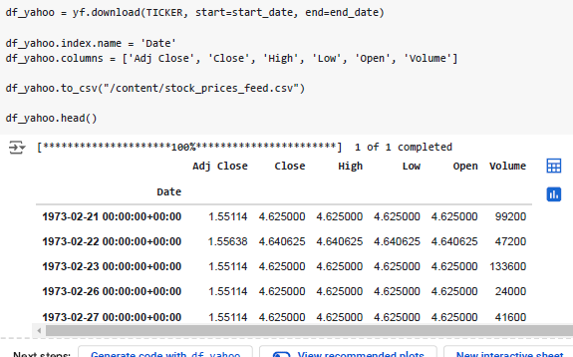
DATA SOURCING
The required historical stock price timeseries data have been captured from Yahoo Finance.
Rationale for Selection of Data Source: The rationale behind choosing this yfinance as data source is easy accessibility, free data access for high volume of data without any registration.
The yfinance library offers Python users a seamless way to retrieve stock data from

Slide 13
LEGAL, ETHICAL & PROFESSIONAL CONSIDERATIONS
Data Protection & Privacy
Used only publicly available data (Yahoo Finance, Twitter APIs)
No personally identifiable information (PII) was accessed or stored
Complied with GDPR and platform-specific terms of service
Responsible Use of APIs & Tools
Employed open-source tools: yfinance, PySpark, Keras, scikit-learn, etc.
Adhered to API rate limits and licensing agreements
Prioritized transparency, inclusiveness, and reproducibility
AI Ethics & Model Integrity
Focused on explainable and interpretable models (e.g., LSTM, clustering, GARCH)
Addressed potential bias in sentiment data and financial signals
Provided clear risk disclosure—no live trading or real-money guarantees
Marked all work as educational/research use only
Academic Integrity & Intellectual Property
Followed APA referencing and open-source license compliance
No unauthorized use of proprietary data/tools
Ethical approval checklist completed and approved by university

Slide 14
Continued..
Social & Professional Responsibility
Avoided high-frequency trading (HFT) practices to ensure market fairness
Tools designed to be accessible and inclusive for broader educational use
Promotes democratization of financial research
Legal & Regulatory Awareness
No engagement in real trading or brokerage activity
Considered relevant AI and financial regulations (e.g., OECD, EU AI Guidelines)
Conclusion
Project upholds ethical AI standards in finance
Provides a responsible AI framework emphasizing privacy, fairness, transparency, and impact
Encourages future practitioners to adopt similar ethical safeguards
This dissertation has been developed with a firm commitment to ethical standards, professional responsibility, and academic integrity.

Slide 15
RESULTS & DISCUSSION
1. Stock Price Prediction (BAC)
LSTM with Attention:
MAE: 0.0572 | RMSE: 0.0663 | Loss: 0.0044
Captured temporal patterns effectively; attention + SHAP improved Explainability
Comparison – Traditional Models:
Linear Regression: Best overall (MSE: 0.2385, R²: 0.9989)
GBT: Moderate; good for nonlinear trends
Decision Tree: Overfitting issues
2. Unsupervised Strategy – S&P 500
K-Means + RSI Initialization for monthly clustering
Momentum-based portfolios via Efficient Frontier
Outperformed SPY (Sharpe ↑)
3. Sentiment-Based NASDAQ Strategy
Top 5 Twitter-sentiment stocks monthly
Outperformed QQQ in downturns (e.g., 2022)
Lower volatility; diversified returns

Slide 16
Continued..
Intraday Models, Summary & Insights
4. Intraday GARCH-Based Strategy
GARCH(1,3) + RSI, MACD, Bollinger Bands
Profitable in volatile regimes
Better reversal signals, but real-time deployment complex
Strategy | Accuracy/Return | Risk Control | Complexity | Generalizability
LSTM Forecasting | High | Medium | High | Moderate
Linear/GBT | High | Low | Low | Low
Clustering (S&P500) | High | High | Medium | High
Sentiment (NASDAQ) | Medium | High | Medium | Medium
GARCH Intraday | Medium | High | High | Low

Slide 17
CHALLENGES
a. Data Quality and Integrity
Survivorship bias was a significant concern in the stock clustering module. Many historical datasets exclude delisted companies, skewing performance metrics.
Noise and spam in Twitter sentiment analysis required heavy filtering, and engagement metrics were manually designed to detect meaningful interaction.
Intraday datasets had inconsistent timestamps and missing entries that had to be interpolated and aligned before GARCH modelling.
b. Model Complexity vs. Explainability
While LSTM models performed reasonably well, their black-box nature conflicted with the goal of Explainability. This was mitigated through SHAP values and visual diagnostics, but simpler models (e.g., GARCH, sentiment scores) remained more transparent.
Clustering outcomes were sensitive to feature scaling and initialization, requiring careful tuning and domain-guided configuration (e.g., RSI-based seeds).
c. API and Access Limitations
API rate limits (Twitter and Yahoo Finance) occasionally disrupted data collection, especially during sentiment windowing and real-time clustering simulations..
Open-source libraries were powerful but sometimes lacked robust support or long-term maintenance, raising concerns for live-trading deployment.

Slide 18
continued..
d. Data Quality and Integrity
GARCH models and rolling technical indicators required high-resolution intraday data processing, which introduced performance bottlenecks—especially when simulating multiple assets.
Some Python notebooks showed that distributed processing (e.g., with PySpark) could help scale strategy development, but was not fully integrated due to time and infrastructure constraints.
e. Generalizability and Overfitting Risks
The use of fixed periods for backtesting raises the issue of non-stationarity in markets—what works historically may not persist in the future..
Strategies were deliberately kept simple and interpretable, but future extensions (e.g., deep reinforcement learning) may require more sophisticated risk control mechanisms.
Future Risks and Ethical Trade-offs
As AI models become more powerful, there is a risk of market manipulation, especially if sentiment analysis is exploited without controls.
Increased automation can lead to deskilling of human analysts and widen the accessibility gap between institutional and retail investors.
There is a moral responsibility to ensure models do not amplify volatility or exacerbate inequity in financial systems.

Slide 19
FUTURE WORK
This dissertation lays a robust foundation for applying machine learning to trading strategies through four core modules: LSTM-based price prediction, unsupervised clustering, Twitter sentiment investing, and intraday GARCH modelling. Future work can significantly expand both the technical sophistication and practical application of these strategies.
LSTM-Based Price Prediction: Future models can adopt more advanced architectures such as BiLSTM, GRU, or transformer-based models for improved long-range time series forecasting. Integration of macroeconomic variables or multi-asset datasets may further enhance predictive accuracy.
Building an Unsupervised Learning Trading Strategy: Extending clustering strategies with dynamic re-clustering, regime-based switching, or ensemble methods could improve adaptability. Factor exposure and ESG scoring could also be added to refine portfolio selection.
Building a Twitter Sentiment Investing Strategy: Expanding sentiment sources to include Reddit (e.g., r/WallStreetBets), news feeds, and YouTube transcripts will enrich signal diversity. Transformer-based NLP models (e.g., FinBERT) can replace VADER for more nuanced financial sentiment analysis.

Slide 20
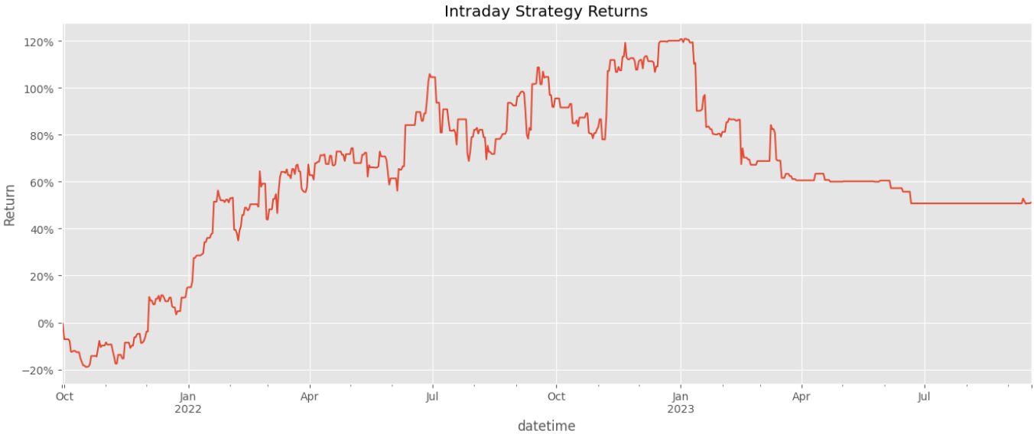
continued..
Building an Intraday Strategy Using GARCH Model: Combining GARCH with machine learning classifiers or reinforcement learning agents may enhance decision-making under volatility. Real-time deployment with broker APIs and transaction cost modelling can bring the strategy closer to production.
Cross-cutting future directions include live trading simulation, risk-aware portfolio optimization, strategy assembling, and building interactive dashboards for real-time Explainability and oversight.
Together, these extensions will elevate the work from educational research to fully scalable, intelligent, and ethical trading systems.

Slide 21
CONCLUSION & TAKEWAYS
This dissertation presents a comprehensive, modular framework for integrating Artificial Intelligence (AI) and Machine Learning (ML) into algorithmic trading, demonstrating how data-driven methods can enhance financial decision-making and portfolio management. The research successfully implements and evaluates four distinct strategies, each leveraging different AI paradigms to target specific trading objectives:
LSTM-Based Price Prediction – A deep learning model capable of capturing temporal dependencies and forecasting stock closing prices.
Unsupervised Learning for Portfolio Construction – A clustering-based approach that groups S&P 500 stocks by behavioural similarity to create diversified, momentum-aware portfolios.
Twitter Sentiment-Based Ranking Strategy – A sentiment-driven model that uses social media engagement as a proxy for investor sentiment to rank and select high-interest NASDAQ stocks.
GARCH-Based Intraday Volatility Strategy – A hybrid statistical-technical model forecasting short-term volatility and generating responsive intraday signals.

Slide 22
continued..
Final Takeaways
AI is Transformational—but Not Magic: While machine learning can outperform static, rule-based strategies, its success depends on thoughtful design, robust data pipelines, and ethical deployment.
No One-Size-Fits-All: Each strategy was best suited to a specific market condition and time horizon—long-term clustering, short-term sentiment surges, or minute-level volatility trades—underscoring the need for context-aware models.
Future-Ready Architecture: This research provides a scalable foundation for further innovation, including real-time strategy execution, deep reinforcement learning, multi-asset trading, and deployment of explainable AI systems in production environments
Conclusion
By demonstrating the viability of combining AI techniques with financial modelling, this dissertation contributes both theoretically and practically to the field of algorithmic trading. The findings reinforce that machine learning is not just a tool, but a strategic enabler—capable of uncovering insights, automating decisions, and adapting to dynamic market environments when used responsibly.
This work sets the stage for future explorations in intelligent, ethical, and transparent trading systems, inviting further research at the intersection of finance, data science, and AI governance.

Slide 23
RESEARCH ARTIFACTS
📄 Final Dissertation Report
Title: “Leveraging Machine Learning for Predictive Price Analytics & Algorithmic Trading
Strategy Optimization
Submission to: Kaplan & University of Portsmouth
Includes: Methodology, experiments, results, ethical analysis
💻 Jupyter Notebooks & Source Code
Developed using Python, TensorFlow, Keras, PySpark, Scikit-learn, yfinance, etc.
Organized into modules:
Data Preprocessing
Clustering Strategy
LSTM Forecasting
Sentiment Analysis
GARCH Volatility Models
Backtesting Framework
🔗 GitHub Repository
URL: https://github.com/ranjankumar03/Master-of-Science-MS---Artificial-Intelligence-and-Machine-Learning/tree/main/THESIS_MASTERS/
Includes this Powerpoint, Final Dissertation Report, Jupyter Notebooks & Source Code
Follows open-source best practices and ethical usage disclaimers

Slide 24
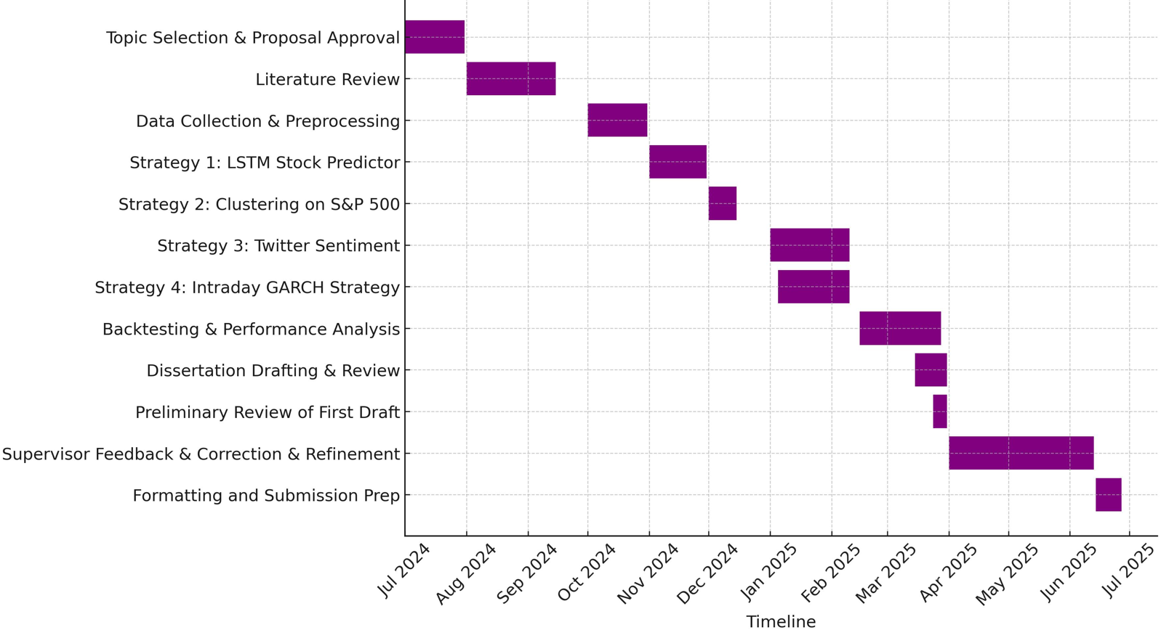
PROJECT PLANNING – GANTT CHART TIMELINE

Slide 25

Thank you for listening

